Slide 1
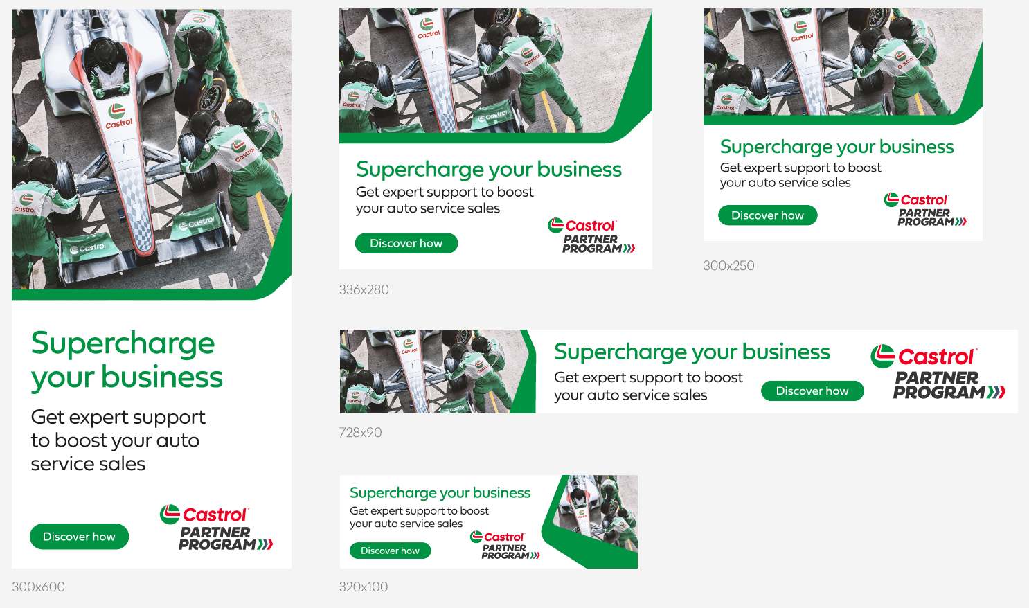
Castrol Partner Program Display Ads
Link ‘discover now” to:
Castrol Partner Program | Castrol® USA

